Slide 1
Getting Started with Wireless IoT
Rob Lauer & TJ VanToll
Developer Relations

Slide 2
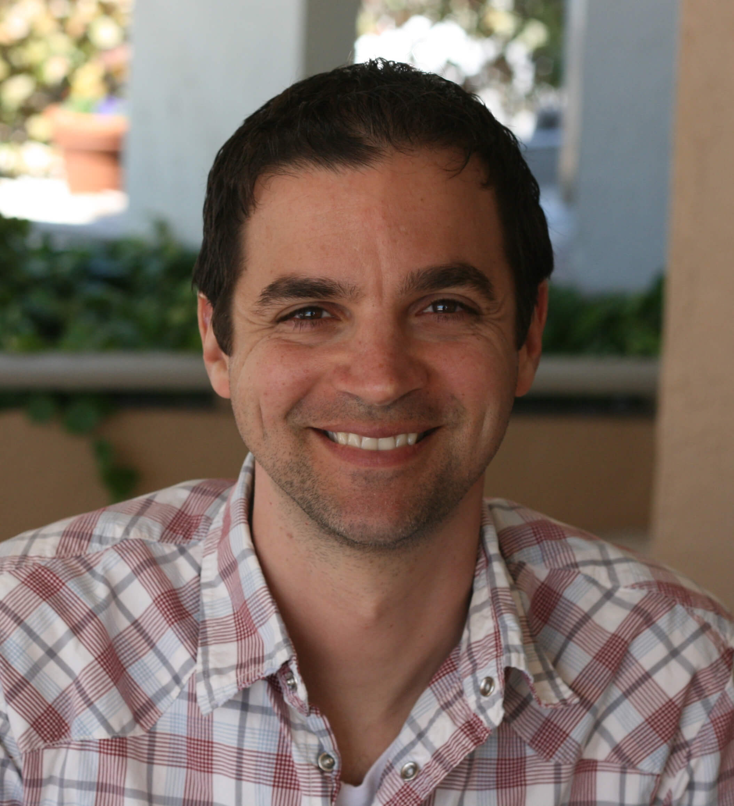

Rob Lauer
TJ VanToll
Director of Developer Relations
@RobLauer
Principal Developer Advocate
@TJVanToll

Slide 3
Complexity kills. It sucks the life out of developers, it makes products difficult to plan, build, and test.
Ray Ozzie – Blues CEO

Slide 4
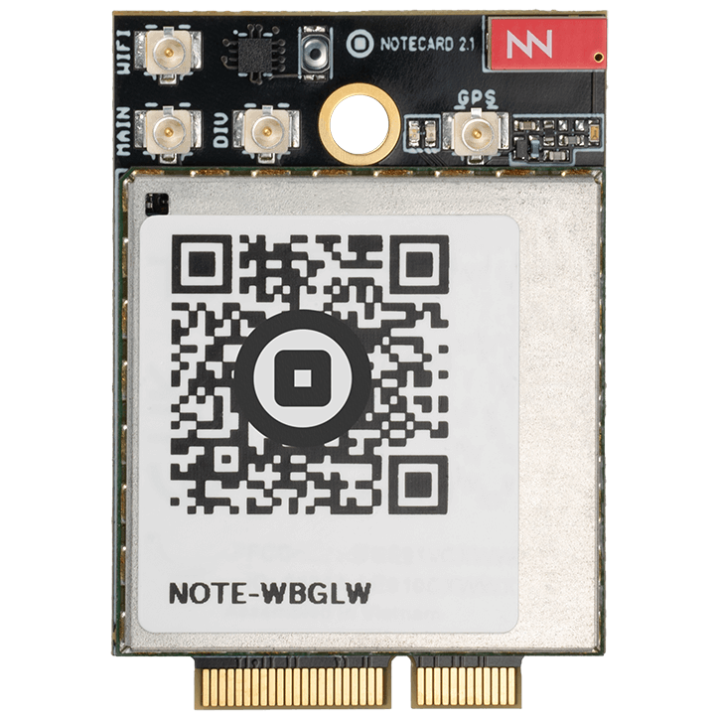
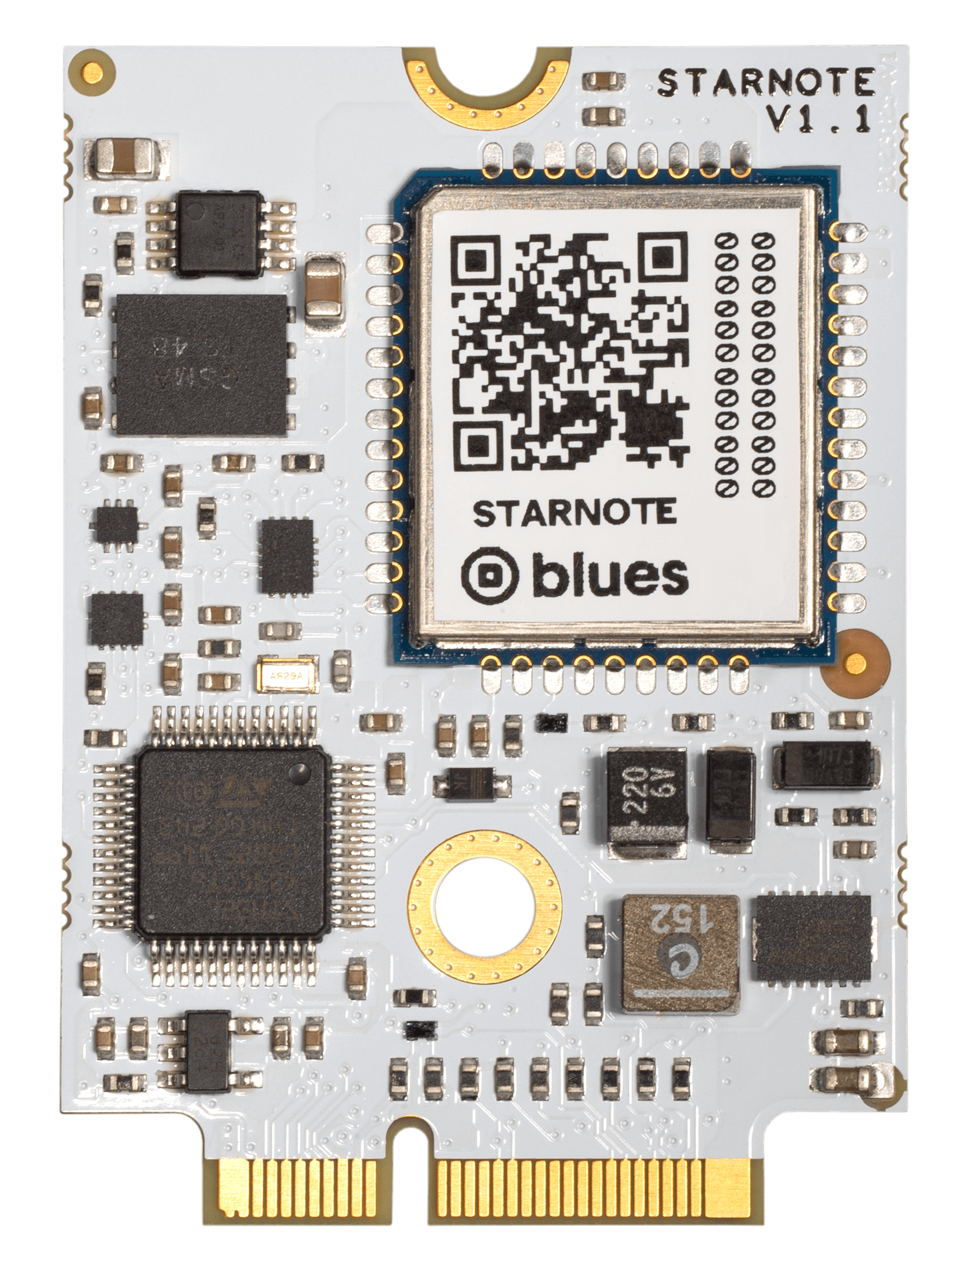
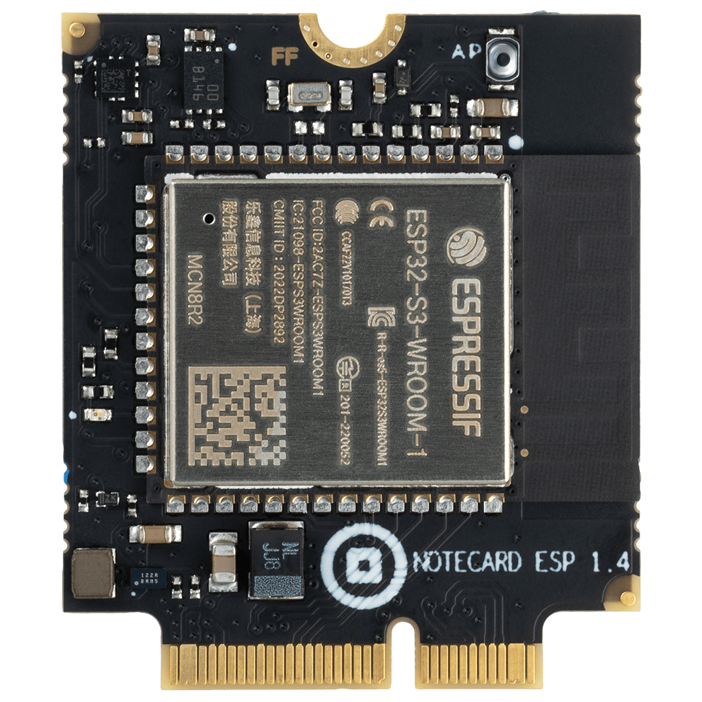
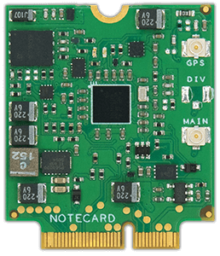
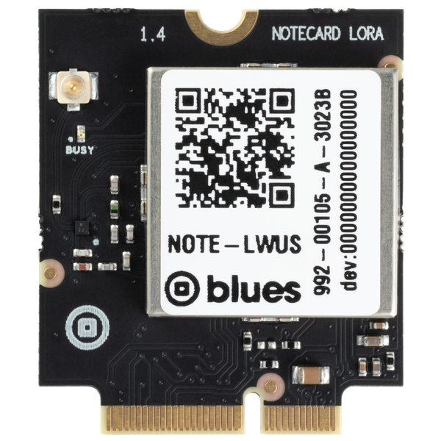
Today’s Agenda
Intro to the Blues Ecosystem
Hands-on Demonstration of Wireless IoT

Slide 5



Slide 6
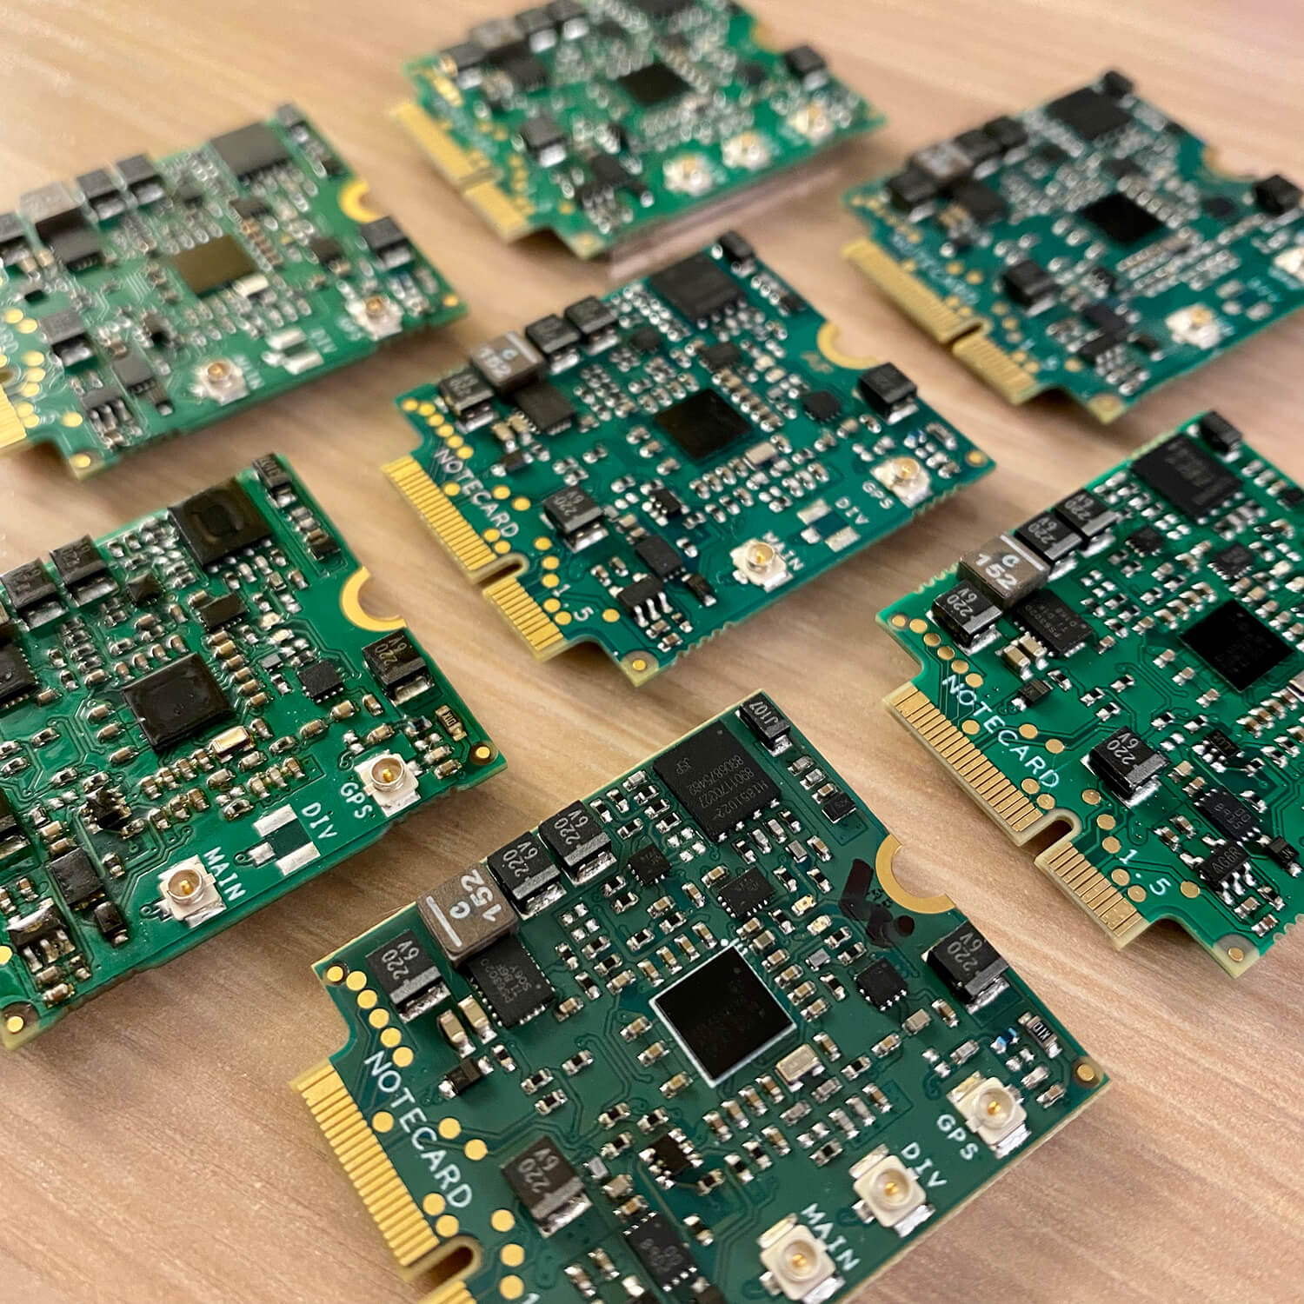
“Making wireless connectivity easier for developers and more affordable for all”

Slide 7

Easy for developers and affordable for all.
🔒 Securing your data from device to cloud
🔋 Building zero-config low-power hardware
👩‍💻 Providing an unmatched developer experience
♻️ Harmonizing the IoT with interchangeable RATs

Slide 8













Develop
…then Decide!

Slide 9

“Device-to-Cloud Data Pump”
🔒

Slide 10
The Notecard Options, Simplified
Cellular
LoRa
Cell + Wi-Fi
Satellite
Wi-Fi

Slide 11
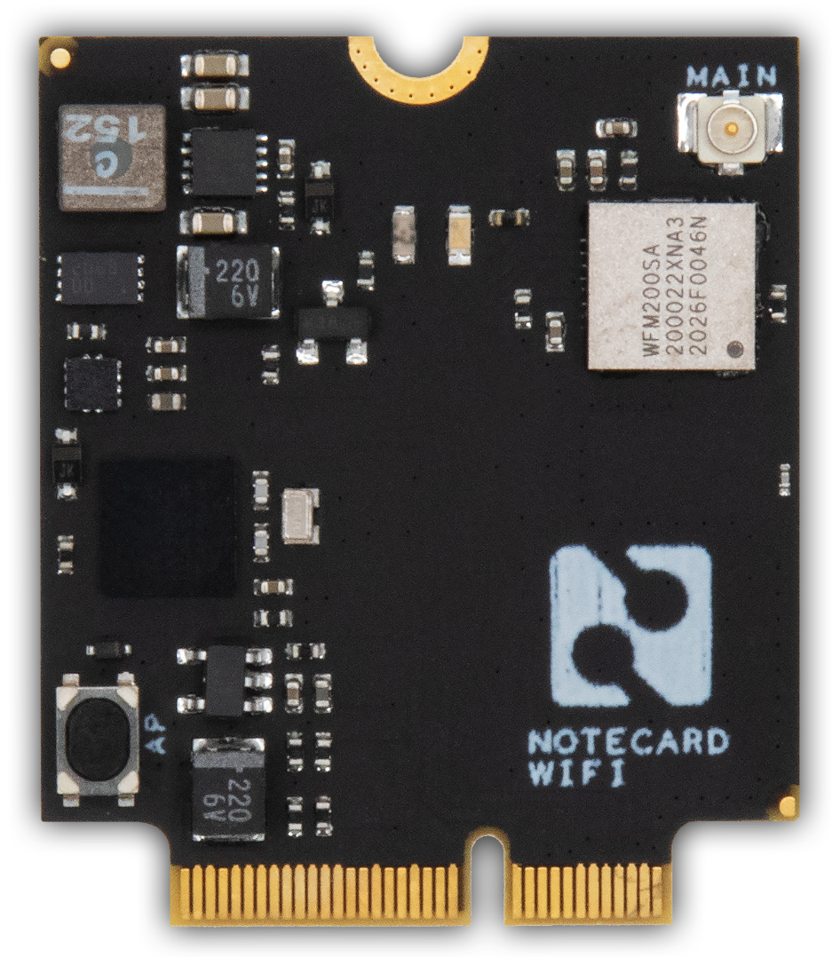
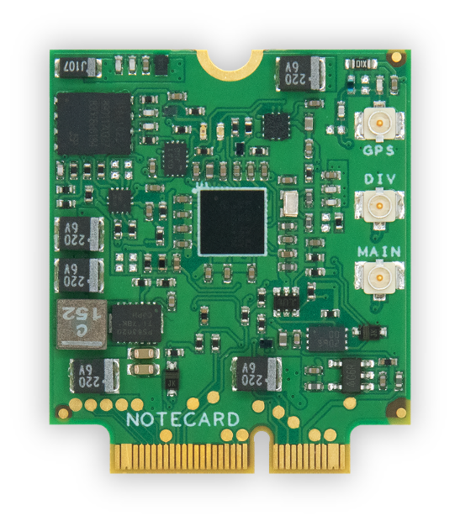
Notecard
Low-power system-on-module
Global Cellular/GPS, Wi-Fi, LoRa, Sat
500MB cell data + 10 years service
Dual SIM support
JSON-based API
Python, Go, Arduino, C/C++, Zephyr
NB-IoT, LTE-M, LTE Cat-1

Slide 12
Example: card.location API
Request
{ "req": "card.location" }
Response
{
"status": "GPS updated (58 sec, 41dB SNR, 9 sats),
"mode": "periodic",
"lat": 42.577600,
"lon": -70.871340,
"time": 1598554399
}

Slide 13
C Example: card.location API
Request
J *req = NoteNewRequest("card.location");
Response
J *rsp = NoteRequestResponse(req);
J *status = JGetString(rsp, "status");
J *mode = JGetString(rsp, "mode");
…etc…

Slide 14
What don’t you need with Blues?
⛔️ SIM or Separate Mobile Plan
⛔️ AT Commands or Cellular Radio Management
⛔️ Custom Security Implementation
⛔️ Roll-Your-Own OTA Firmware Updates
⛔️ Power Management
⛔️ Custom Cloud Integration
⛔️ Certifications

Slide 15
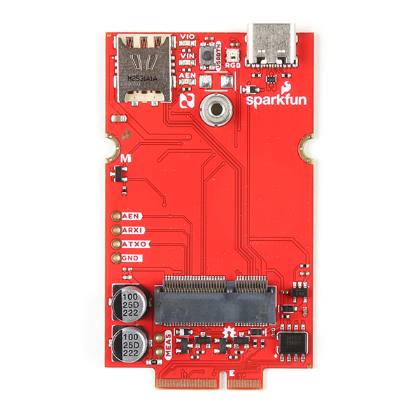
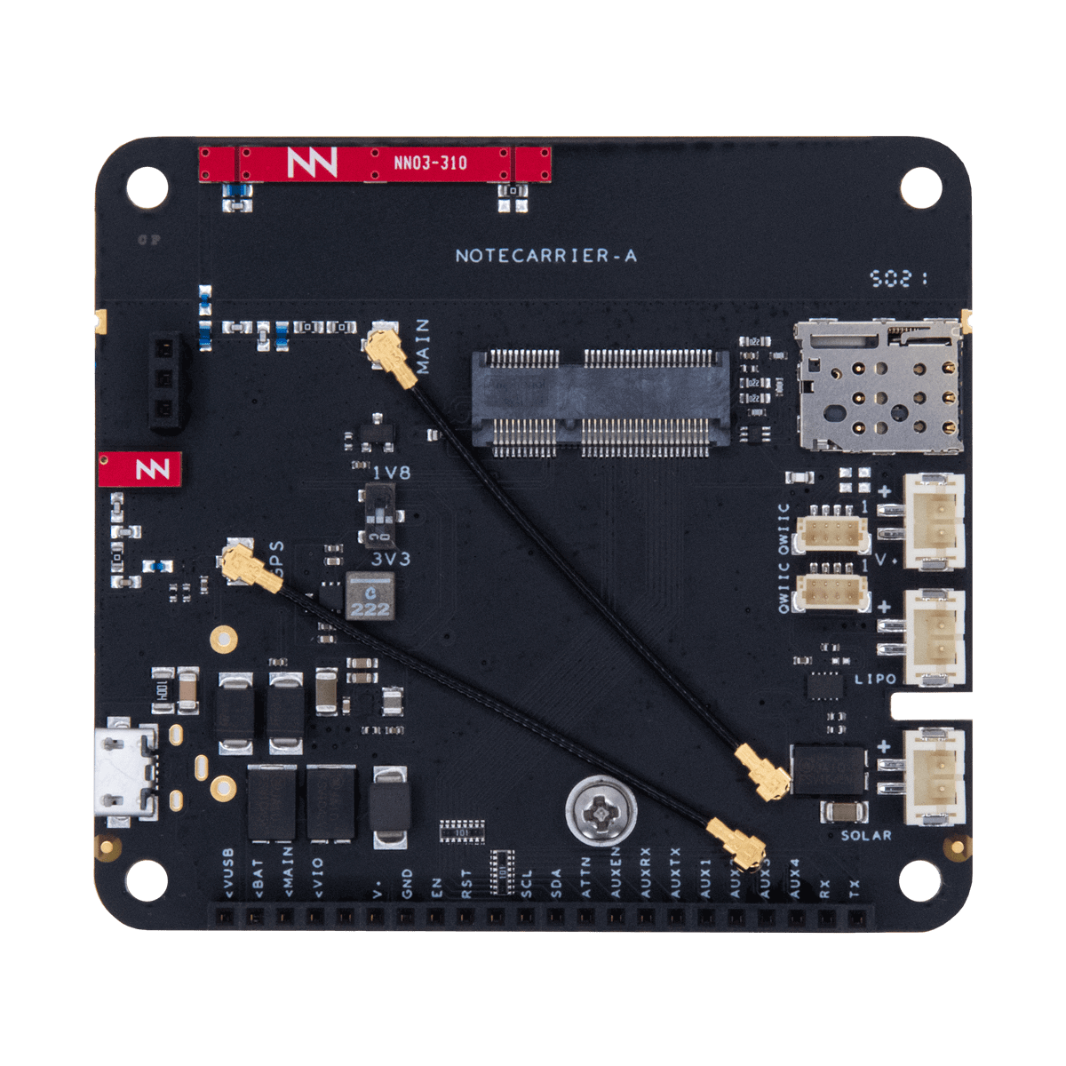
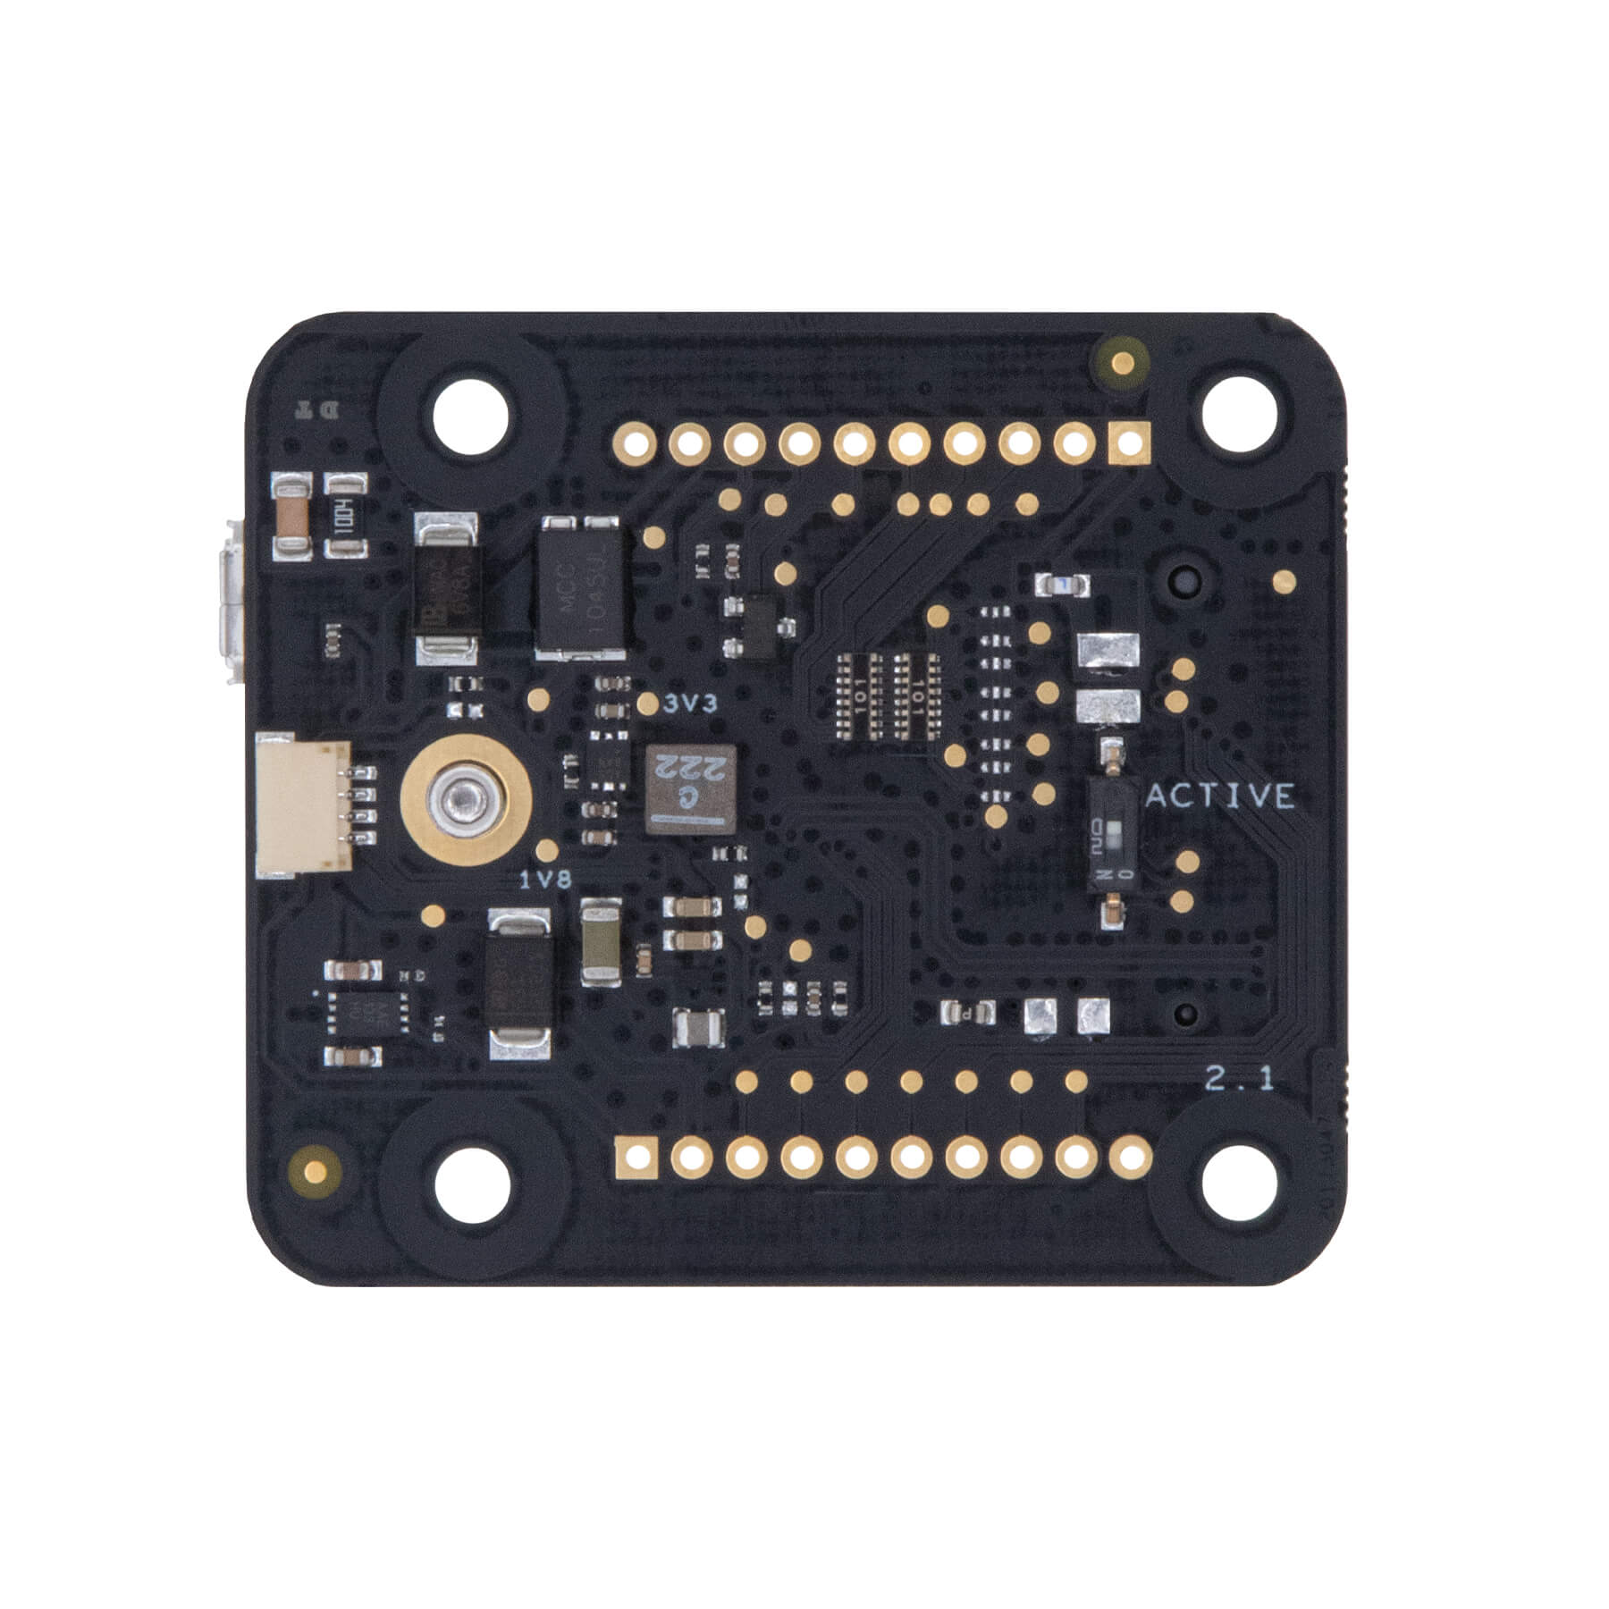
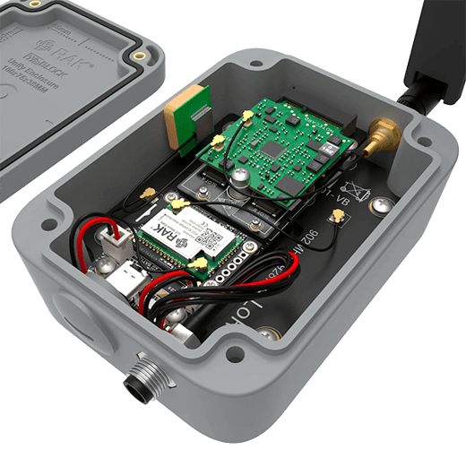
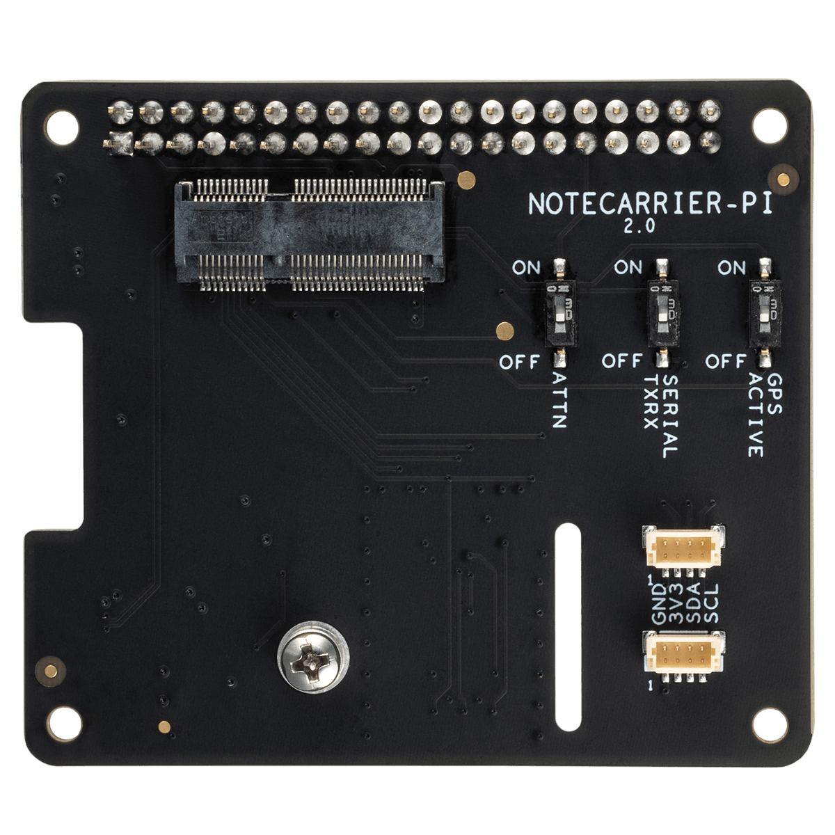
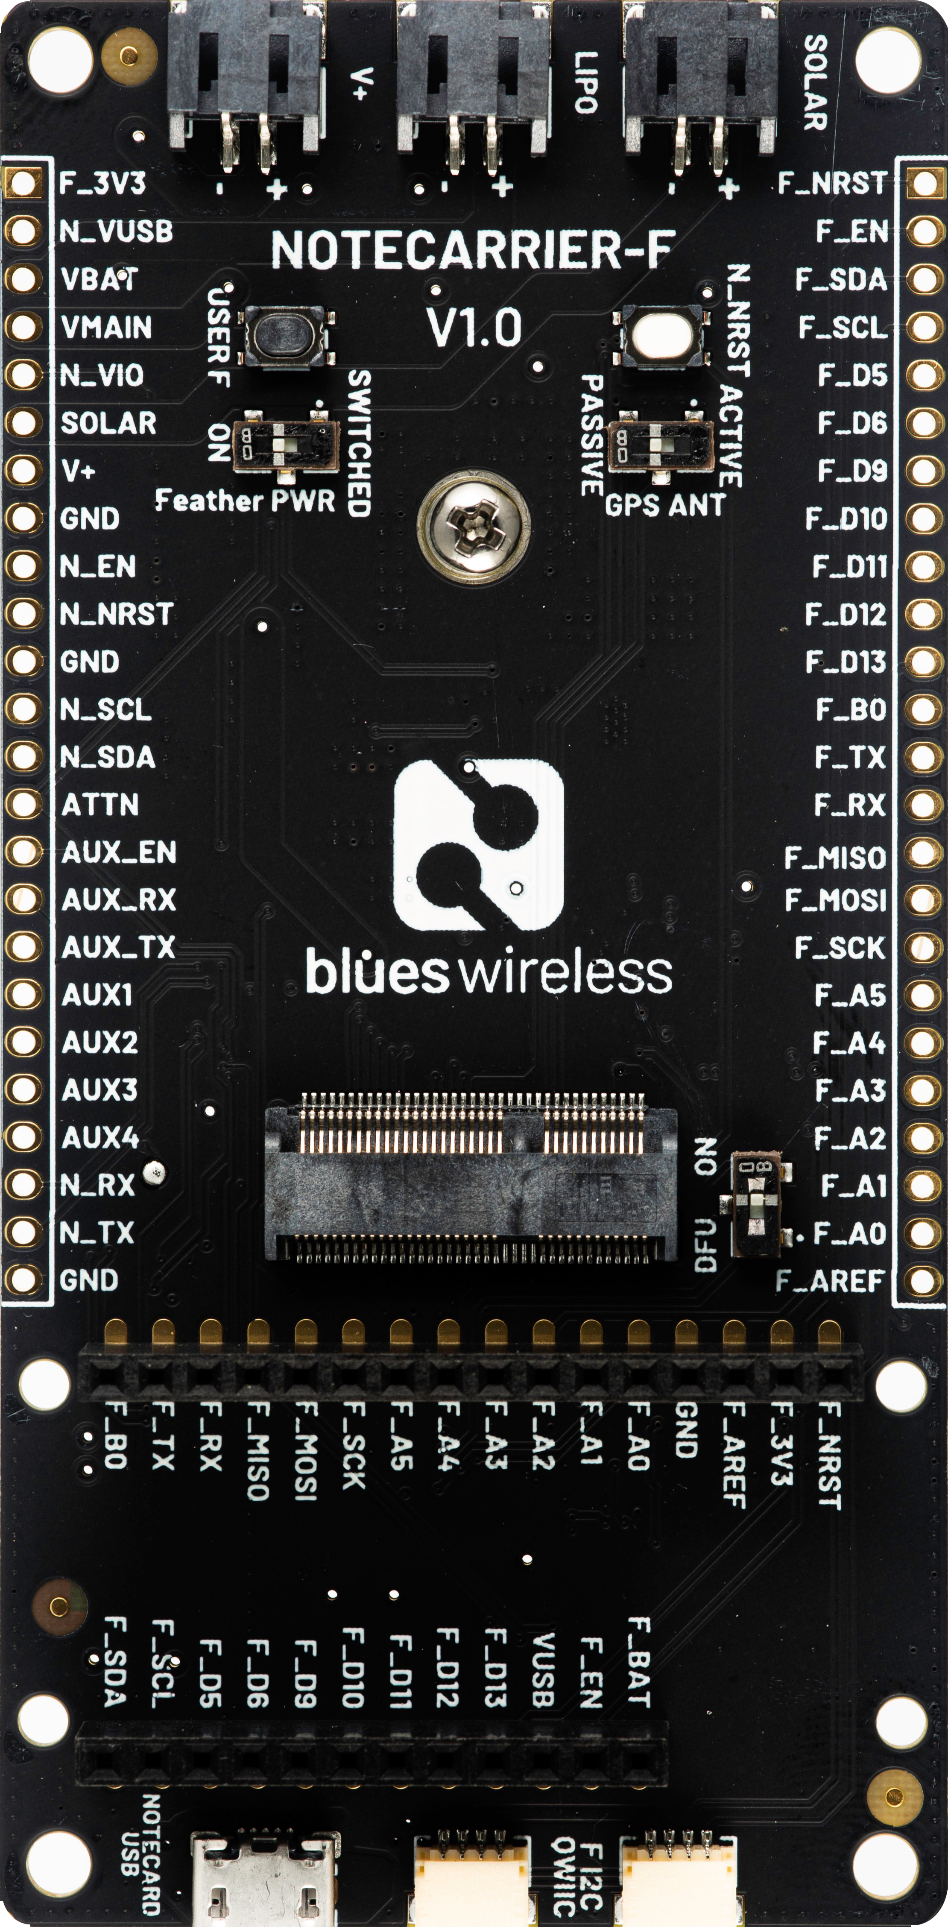
Notecarrier
Carrier boards for easy prototyping
Notecarrier for every scenario:
F – Feather-compatible socket
A – Any MCU, onboard antennas
B – Small form factor
Pi – Raspberry Pi SBC
SparkFun MicroMod Cellular Function
Blues.ONE from RAKwireless

Slide 16
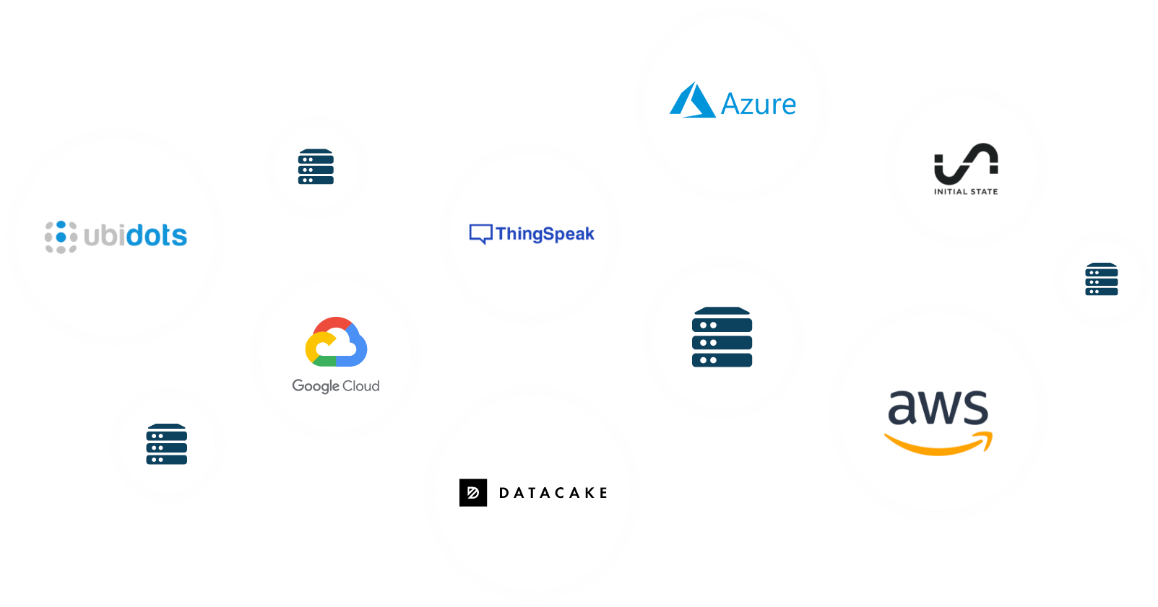
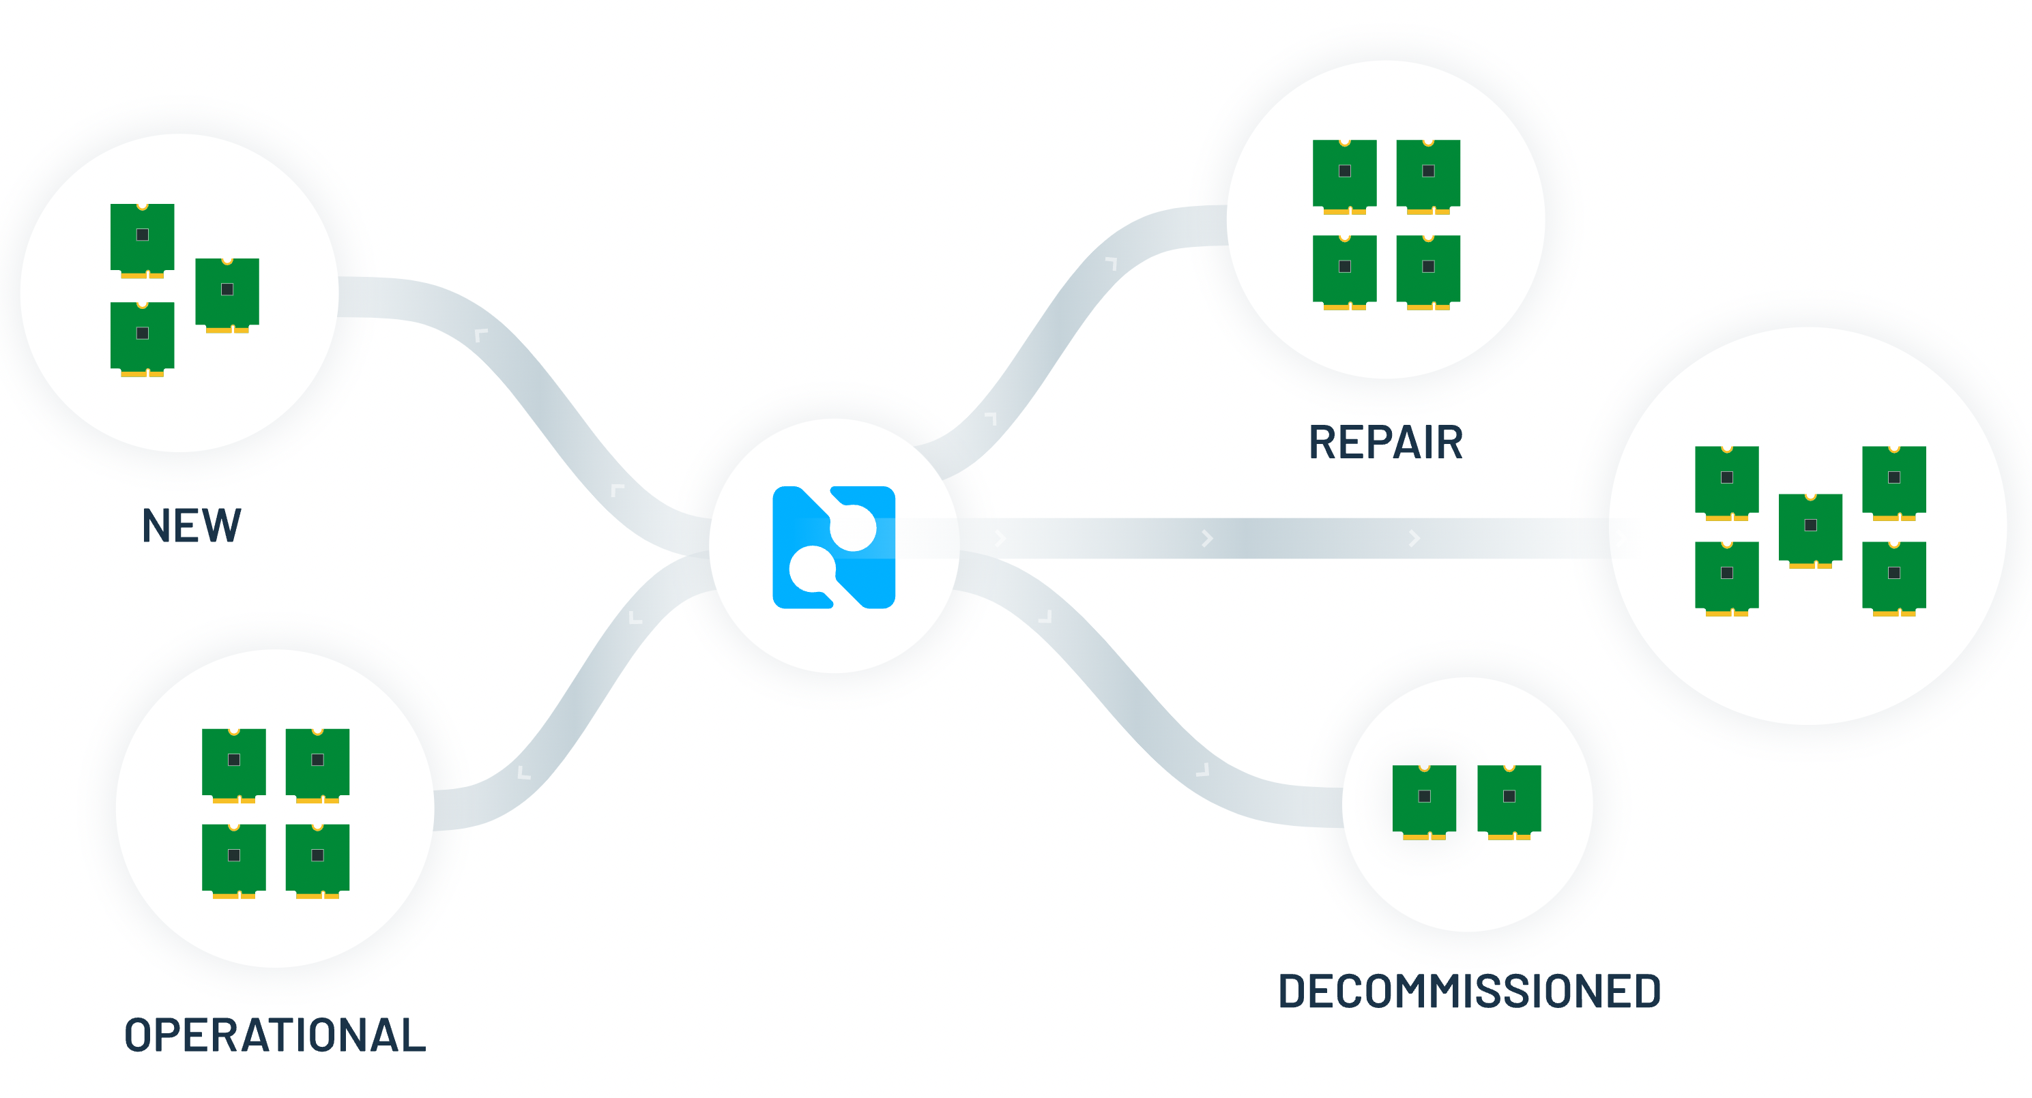

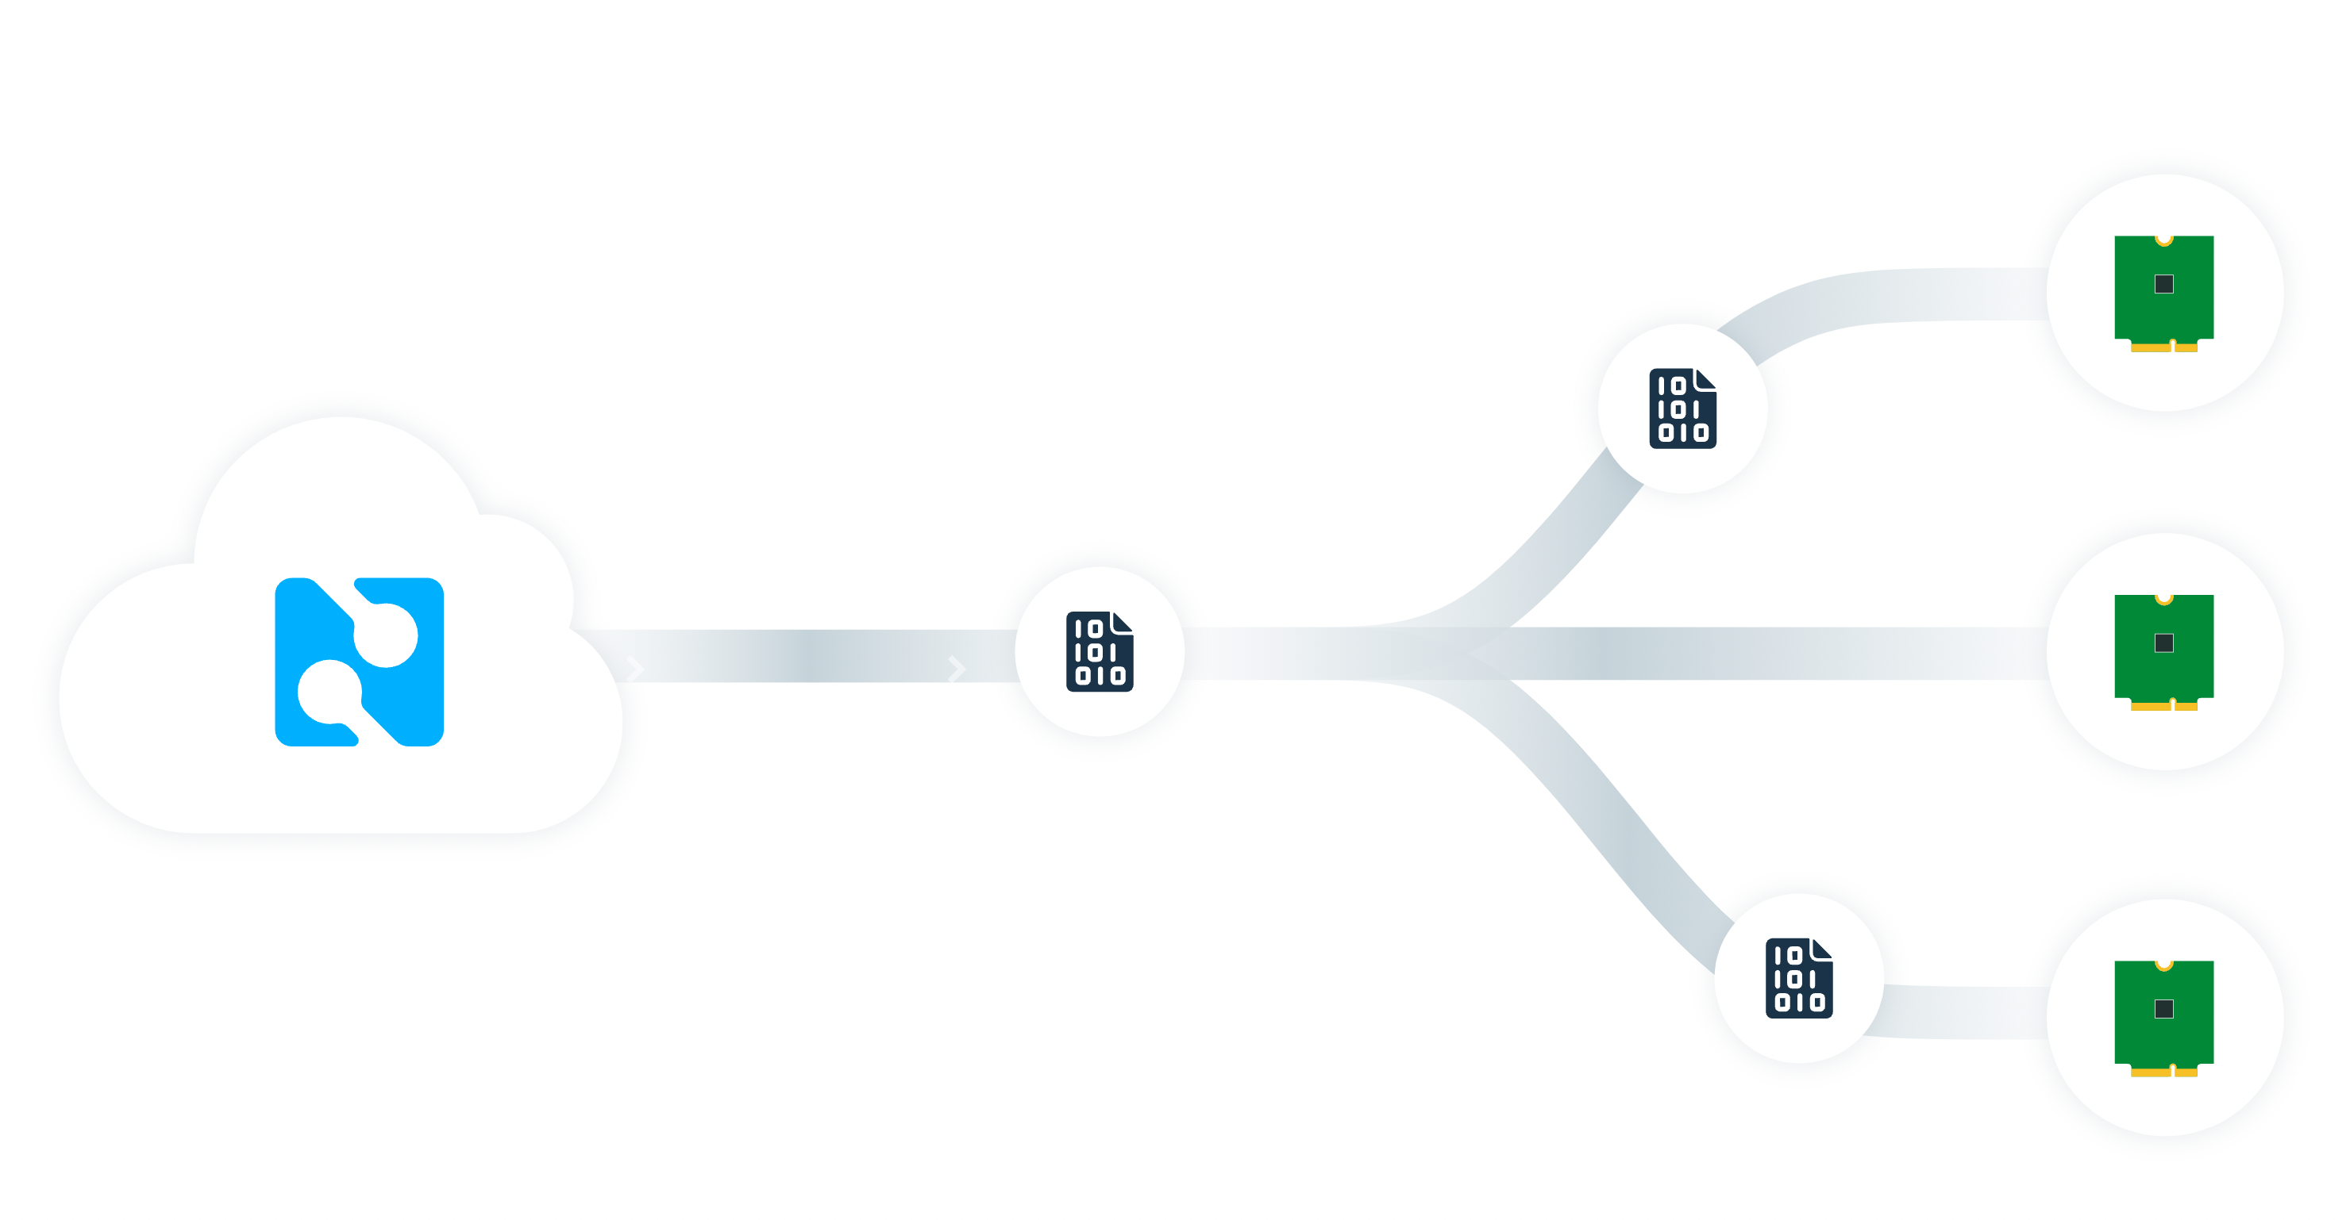
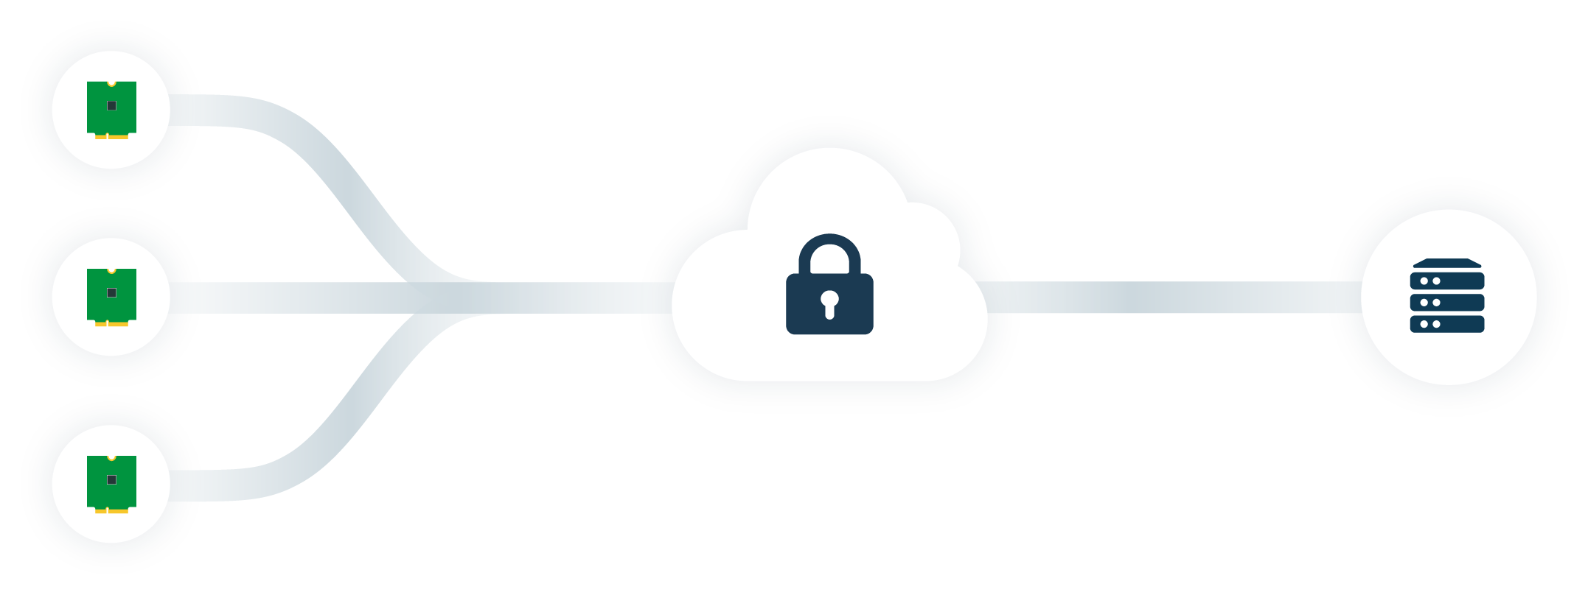
Notehub
Secure cloud proxy for Notecards
Route data to any cloud app
Manage fleets of devices
OTA MCU/Notecard firmware updates
Secure communications

Slide 17
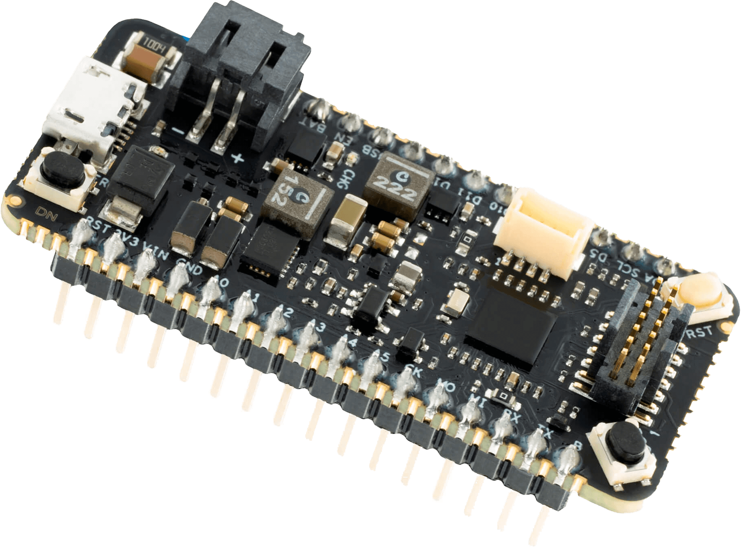
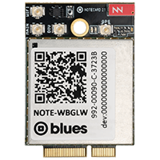


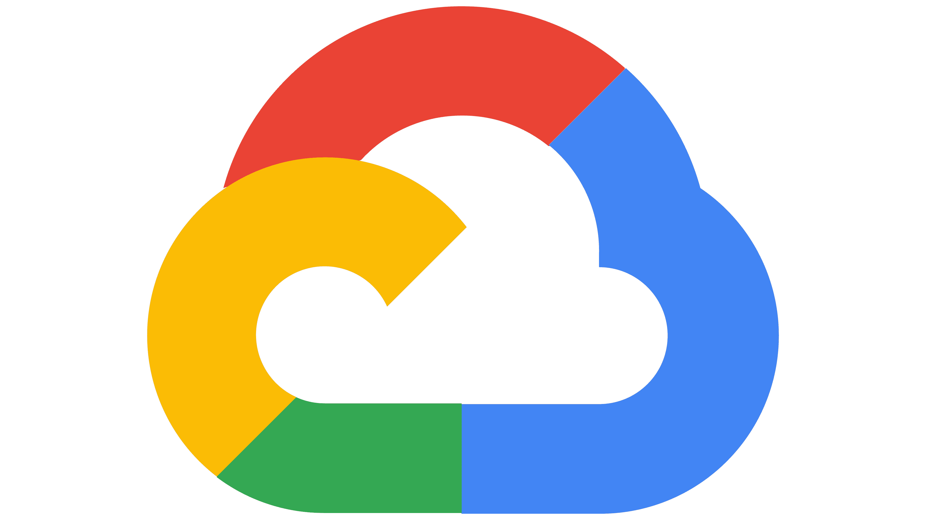
Outbound Communication (from Host to Cloud)
{JSON}
{JSON}
🔒📡️🔒
Your MCU/SBC
Your Sensors
Your Language
Notecard Cellular, Wi-Fi, and/or LoRa
Blues
Notehub
Any Cloud
Arduino
C/C++
Python
JSON
J *req = NoteNewRequest("note.add");
JAddStringToObject(req, "file", "data.qo");
J *body = JCreateObject();
JAddNumberToObject(body, "temp", 27.3);
JAddItemToObject(req, "body", body);
NoteRequest(req);
{
"file": "data.qo",
"temp": 27.3,
"when": 1644268443,
"lat": 42.11,
"lon": -88.32
"device": "dev:89347"
}

Slide 18
Inbound Communication (from Cloud to Host)
{JSON}
{JSON}
🔒📡️🔒
Your MCU/SBC
Your Sensors
Your Language
Notecard Cellular, Wi-Fi, and/or LoRa
Blues
Notehub
Any Cloud
Arduino
C/C++
Python
JSON
J *req = NoteNewRequest("note.get");
JAddStringToObject(req, "file", "data.qi");
JAddBoolToObject(req, "delete", true);
NoteRequest(req);
{
"file": "data.qi",
"sample_freq": 5,
"notify": true
}

Slide 19
TJ VanToll
Principal Developer Advocate
@TJVanToll

Slide 20
So…what does it all cost?
Notecard
$10 to $69 USD (most common ~$50)
Cellular includes 500MB and 10 years of service
Notehub
5,000 outbound (Notehub to Cloud) FREE each month
Beyond 5,000 you only pay for what you use!
Starting at 15,000 events for $11 USD
No SIM fees or required subscriptions

Slide 21
The Most Important Slide!
Easy (but powerful) Developer Experience
Same Connector and API for Cellular, Wi-Fi, LoRa
Future-Proof Deployment (5G, Satellite, and Beyond)
All Blues Hardware is Low-Power by Design
Guaranteed 10 Years of Cellular Connectivity

Slide 22
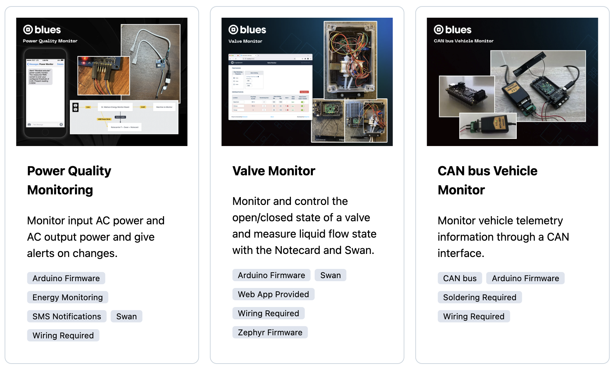
Blues Accelerators
40+ Purpose-Built IoT Solutions
Free and Open Source (Firmware and Cloud)
blues.dev/accelerators

Slide 23
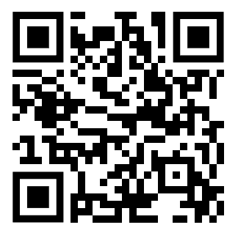
Thanks! (Time for Q&A)
🧑‍💻 blues.dev for Blues developer resources
🏁 Get a Blues Starter Kit @ shop.blues.com
Rob Lauer
TJ VanToll
Senior Director of Developer Relations
Principal Developer Advocate
@RobLauer
@TJVanToll

